Slide 1
Wine Project
Quality of Wine

Slide 2
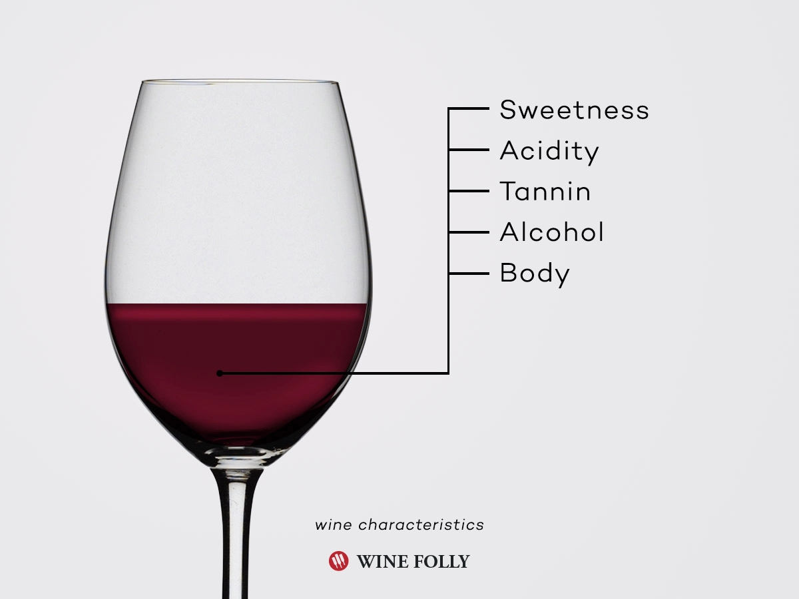

Slide 3


Slide 4
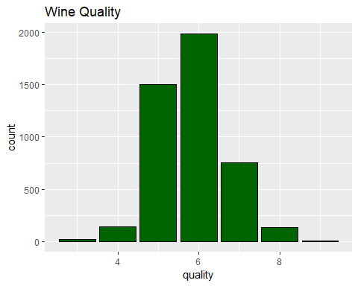

Slide 5
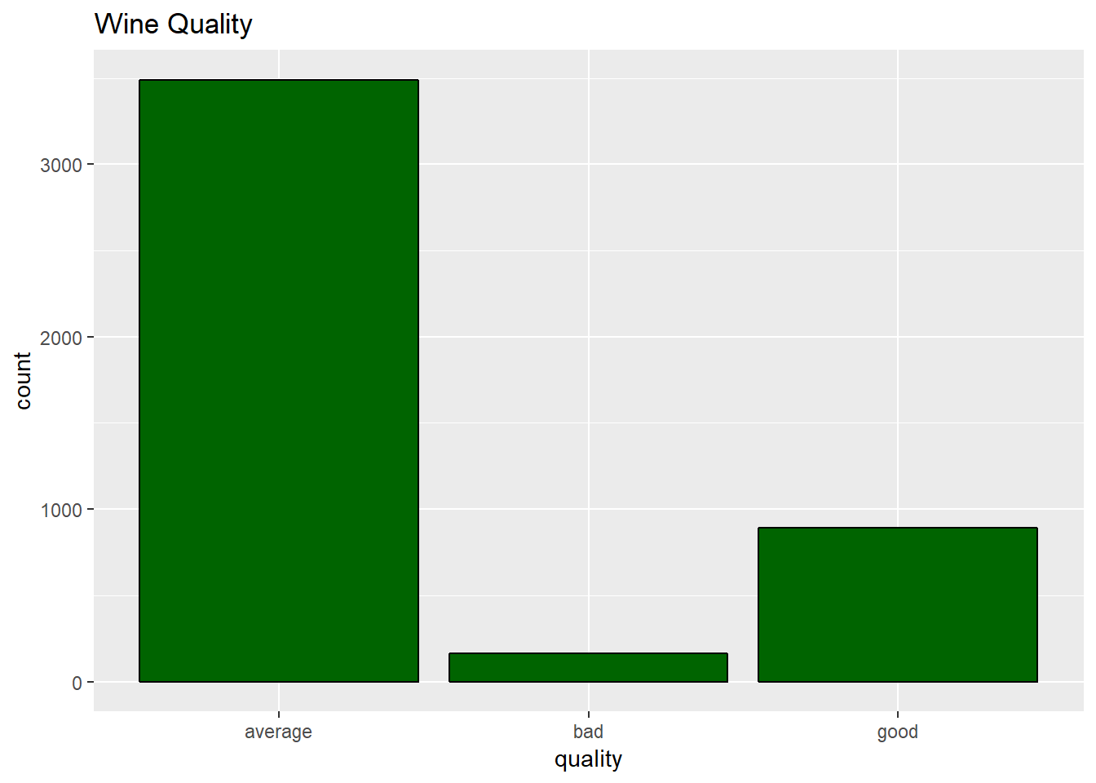

Slide 6
Correlation Matrix
------------------------------------------------------------------ ## &nbsp; sulphates alcohol quality ## -------------------------- ------------ ------------- ------------ ## **fixed.acidity** **0.31** -0.08662 -0.07724 ## ## **volatile.acidity** 0.2275 -0.03961 -0.2724 ## ## **citric.acid** 0.06085 -0.006977 0.08548 ## ## **residual.sugar** -0.1844 **-0.3578** -0.03888 ## ## **chlorides** **0.3925** -0.2604 -0.1977 ## ## **free.sulfur.dioxide** -0.1897 -0.1843 0.05253 ## ## **total.sulfur.dioxide** -0.2758 -0.2657 -0.0454 ## ## **density** 0.2698 **-0.6799** -0.2997 ## ## **pH** 0.2073 0.1094 0.02299 ## ## **sulphates** 1 -0.01265 0.03639 ## ## **alcohol** -0.01265 1 **0.4314** ## ## **quality** 0.03639 **0.4314** 1 ## ------------------------------------------------------------------

Slide 7
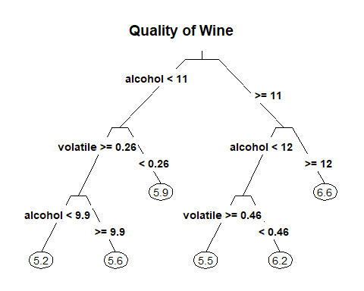

Slide 8
Regression Random Forest
roundpred <- round(pred) table(roundpred, testing$quality)
## ## roundpred 3 4 5 6 7 8 9 ## 5 6 29 297 66 3 2 0 ## 6 3 19 144 488 111 16 1 ## 7 0 1 1 41 109 20 1 ## 8 0 0 0 0 0 5 0
(297+488+109+5)/(1363)
## [1] 0.6595745

Slide 9
Classification KNN
## test_pred average bad good ## average 987 47 179 ## bad 0 0 0 ## good 60 1 89 ## ## Overall Statistics ## ## Accuracy : 0.7894 ## 95% CI : (0.7668, 0.8108) ## No Information Rate : 0.7682 ## P-Value [Acc > NIR] : 0.03263

Slide 10
For the Future
Red or White
More Spread Quality
Classification
Study another variable

Slide 11
